Slide 1
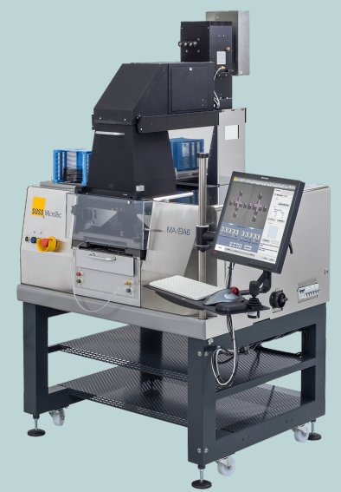
MA6BA6GEN4 TRAINING
kevin chen (13540469265)
kevin.chen@suss.com.cn
陈 威
2022-06-14

Slide 2
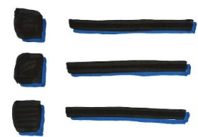
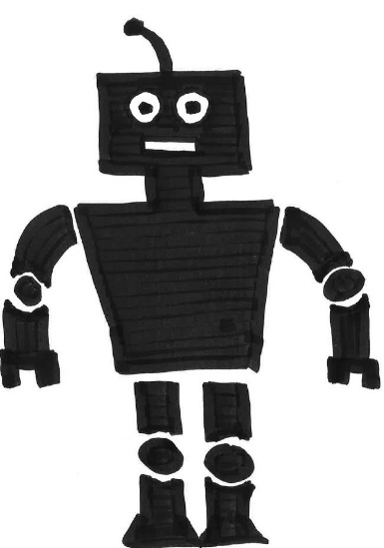
content
1
Hardware Overview
2
Software Overview
3
Operation

Slide 3
Hardware overview
1
Overview Subassemblies
2
Optical system
3
Alignment Stage
4
SUSS Leveling System(WEC)
5
Contact Mode
6
Alignment
7
Pneumatic control
8
TSA/BSA

Slide 4
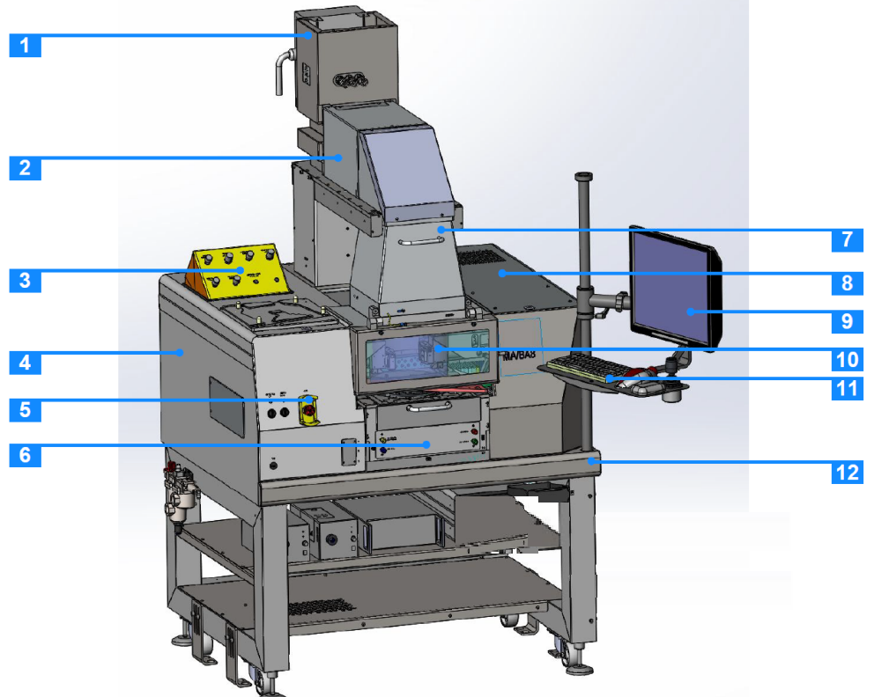
1. Overview Subassemblies
1、Lamp House
2、Optics tube
3、Pneumatic control
4、Pneumatics/inside
5、Emergency Off
6、Alignment Stage
7、Front Lens Tube
8、Electronics/inside
9、Monitor
10、Microscopes
11、Operator Panel
12、Mask Aligner Base Plate

Slide 5
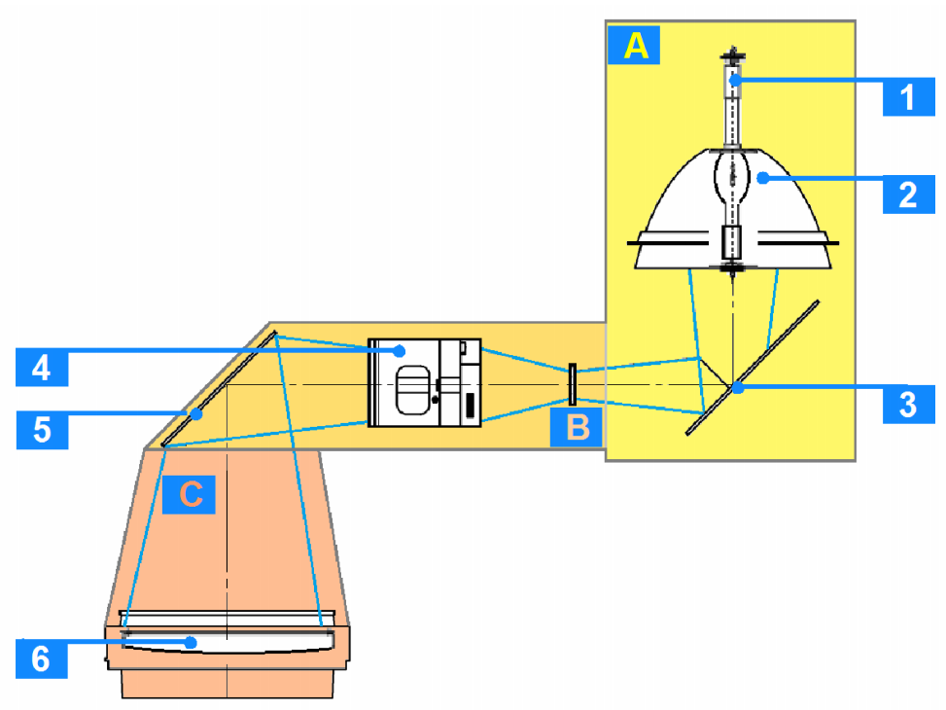
2. Optical system
A、Lamp house
B、Optics Tube
C、Front Lens Tube
LED LAMP
3、Cold Light Mirror
4、Optic lens system
5、Turning Mirror
6、Front Lens

Slide 6
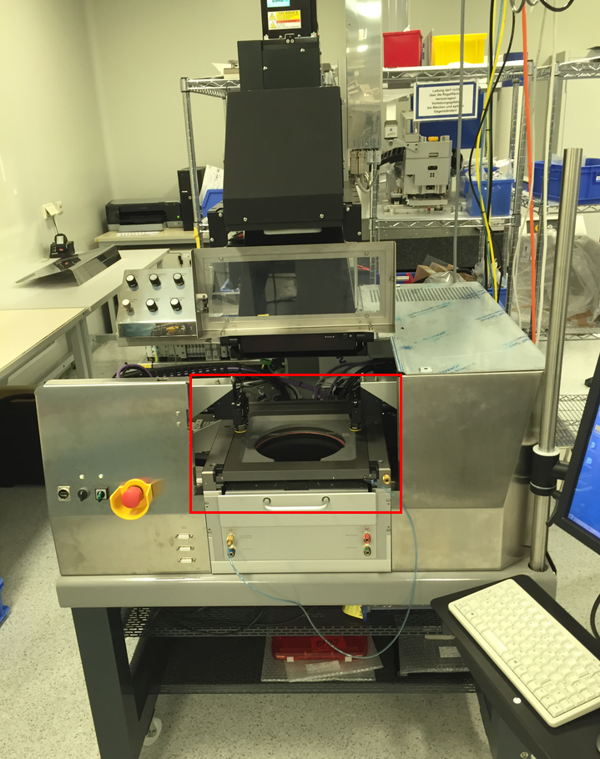
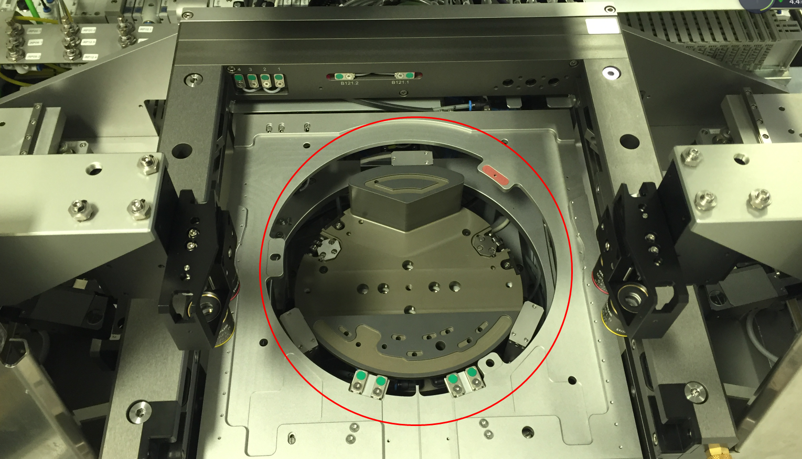
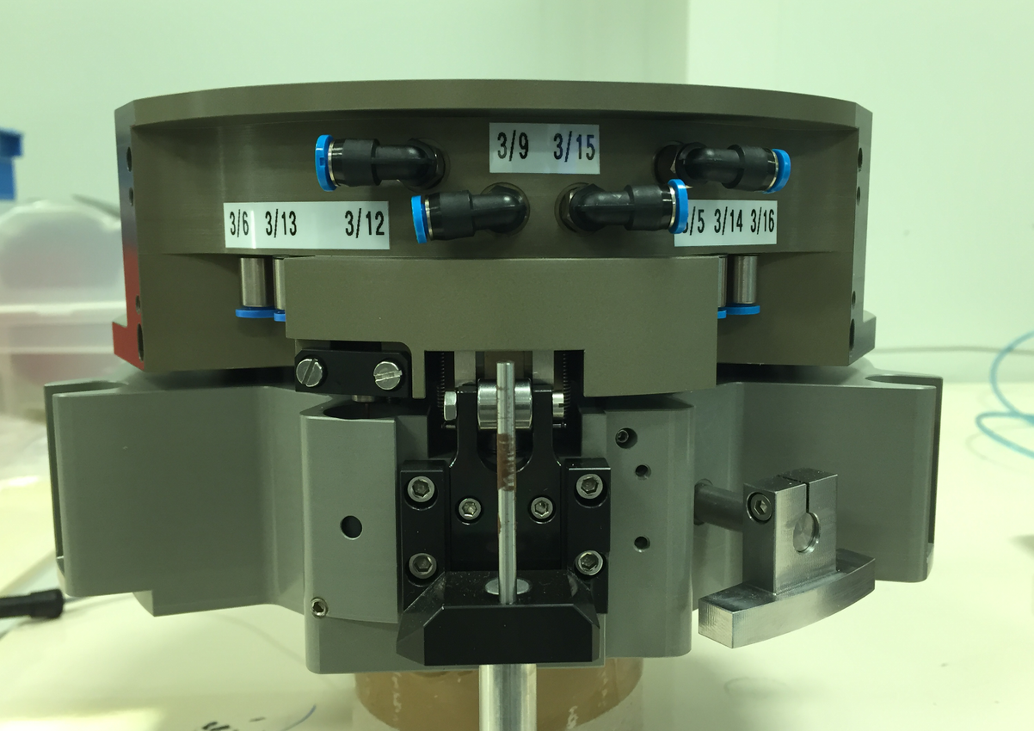
3、Alignment stage
Stage, to put the wafer on the stage, wafer can move in X/Y/Theta direction
WEC, to make the wafer parallelism to mask

Slide 7
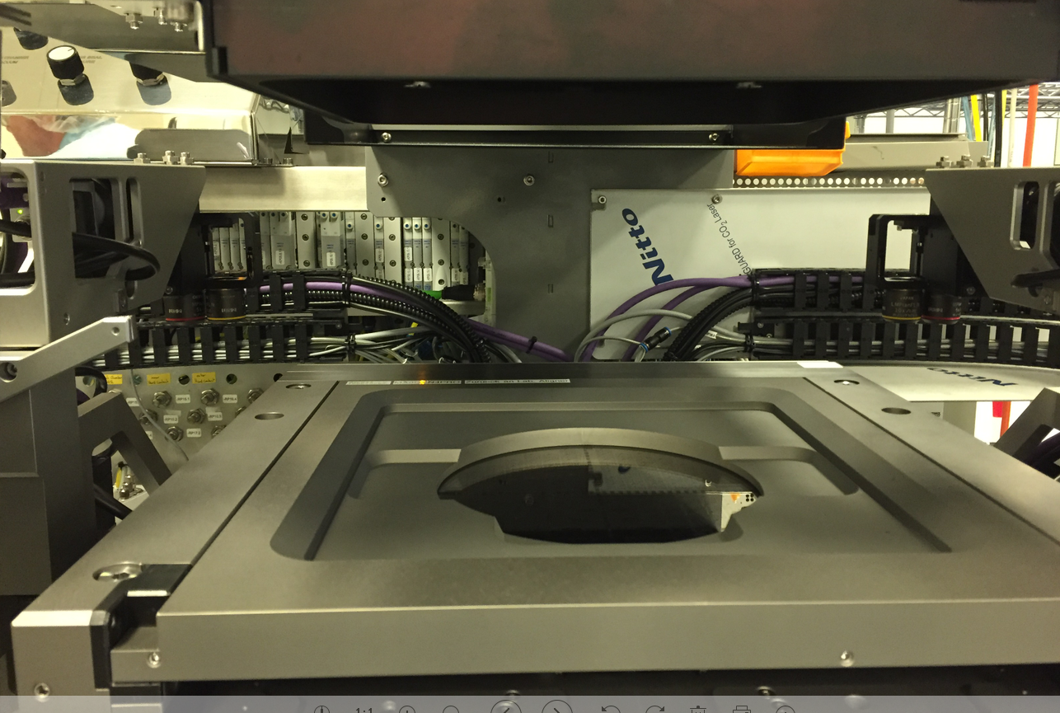
3、Alignment stage
Mask Holder, to hold the mask by vacuum, during the process, mask can not move

Slide 8
4、SUSS Leveling system(wec)
Leveling of mask and wafer essential for good printing results.
Benefits of the patented SUSS leveling system
Simple, robust design
High precision
Reliable long term performance
High speed

Slide 9
4、SUSS Leveling system(wec)
Mask
Mask frame
Proximity spacers

Slide 10
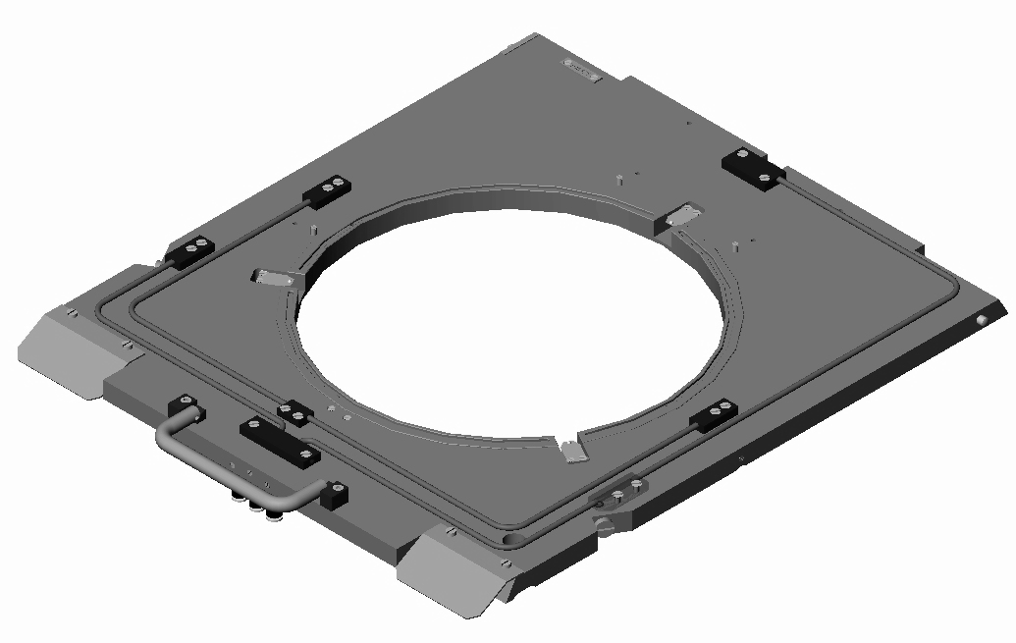
4、SUSS Leveling system(wec)
Positioning pins for mask
Tubing
Proximity
Spacers
Handle
Vacuum
Vacuum/air fittings

Slide 11
4、SUSS Leveling system(wec)
Wafer
Chuck
Pneumatic & Vacuum Connections
Proximity Sensor WEC-Pos.
Wedge-Error Compensation Pistons
Proximity Sensor Base-Pos.
Pneumatic Brake
Precise Ball-Bearing Guide
Stepper Motor Z-Axis

Slide 12
5、Contact mode
Mask
Soft contact
(adjustable mechanical pressure)
Chuck
Vac
Mechanical pressure
Hard contact
(additional nitrogen pressure)
N₂
Mechanical pressure
Vacuum contact
Vac
Mechanical pressure

Slide 13
5、SOFT CONTACT-without spacer
STEP 1
Loading Wafer

Slide 14
5、SOFT CONTACT-without spacer
STEP 1
Loading Wafer

Slide 15
5、SOFT CONTACT-without spacer
STEP 1
Loading Wafer

Slide 16
5、SOFT CONTACT-without spacer
STEP 1
Loading Wafer

Slide 17
5、SOFT CONTACT-without spacer
STEP 2
The vacuum switched on. The Wafer will be fixed.

Slide 18
5、SOFT CONTACT-without spacer
STEP 3
The Z-drive moves the WEC-Head upwards

Slide 19
5、SOFT CONTACT-without spacer
STEP 3
The Z-drive moves the WEC-Head upwards

Slide 20
5、SOFT CONTACT-without spacer
STEP 4
The Z-drive moves the WEC-Head upwards.
The WEC-Head comes in contact with the mask.

Slide 21
5、SOFT CONTACT-without spacer
STEP 5
The Z-drive moves the WEC-Head upwards.
The WEC-Head is in contact with the mask.
The proximity sensor monitored the correct position

Slide 22
5、SOFT CONTACT-without spacer
STEP 6
The Z-drive has stopped by responding the proximity sensor
The WEC-Head is in contact with the mask.
The proximity sensor monitored the correct position.
The chuck is now parallel to the mask and locks in its position by pneumatic break

Slide 23
5、SOFT CONTACT-without spacer
STEP 7
The exposure chuck and the wafer has stopped at corresponding alignment gab.

Slide 24
5、SOFT CONTACT- with spacer
STEP 1
Loading Wafer

Slide 25
5、SOFT CONTACT-with spacer
STEP 1
Loading Wafer

Slide 26
5、soft contact-with spacer
STEP 1
Loading Wafer

Slide 27
5、soft contact-with spacer
STEP 1
Loading Wafer

Slide 28
5、soft contact-with spacer
STEP 2
The vacuum switched on. The Wafer will be fixed.

Slide 29
5、soft contact-with spacer
STEP 3
The Z-drive moves the WEC-Head upwards

Slide 30
5、soft contact-with spacer
STEP 4
The spacer forward between mask and wafer

Slide 31
5、soft contact-WITH SPACER
STEP 5
The Z-drive moves the WEC-Head upwards

Slide 32
5、soft contact-WITH SPACER
STEP 6
The Z-drive moves the WEC-Head upwards.
The WEC-Head comes in contact with the spacer.

Slide 33
5、soft contact-WITH SPACER
STEP 7
The Z-drive moves the WEC-Head upwards.
The WEC-Head is in contact with the mask.
The proximity sensor monitored the correct position

Slide 34
5、soft contact-WITH SPACER
STEP 8
The Z-drive has stopped by responding the proximity sensor
The WEC-Head is in contact with the mask.
The proximity sensor monitored the correct position.
The chuck is now parallel to the mask and locks in its position by pneumatic break

Slide 35
5、soft contact-WITH SPACER
STEP 9
The Z-drive moves the WEC-Head downwards

Slide 36
5、soft contact-WITH SPACER
STEP 10
The Z-drive moves the WEC-Head downwards
The spacer retract

Slide 37
5、soft contact-with spacer
STEP 11
The Z-drive moves the WEC-Head downwards
The spacer retract
If an alignment program has been chosen, the exposure chuck and the wafer are moving along the Z-axis into the corresponding alignment gap

Slide 38
6、alignment
STEP x :
The Z-drive has stopped by responding the alignment position
The chuck is locked by applying a pneumatic break
Moving the stage to get the right position to the mask key

Slide 39
6、alignment
STEP x :
The Z-drive has stopped by responding the alignment position
The chuck is locked by applying a pneumatic break
Moving the stage to get the right position to the mask key

Slide 40
6、alignment
STEP x :
The Z-drive has stopped by responding the alignment position
The chuck is locked by applying a pneumatic break
Moving the stage to get the right position to the mask key

Slide 41
6、alignment
STEP x :
The Z-drive moves upwards to the exposure position
The chuck is locked by applying a pneumatic break

Slide 42
6、alignment
STEP x :
The Z-drive has stopped by responding the exposure position
The chuck is locked by applying a pneumatic break

Slide 43
6、ALIGNMENT
STEP x :
The Z-drive has stopped by responding the exposure position
The chuck is locked by applying a pneumatic break
The wafer will be exposured by UV-Light

Slide 44
6、ALIGNMENT
STEP x :
The Z-drive has stopped by responding the exposure position
The chuck is locked by applying a pneumatic break
The wafer is exposured

Slide 45
6、ALIGNMENT
STEP x :
The Z-drive moves downwards to the base position
The chuck is locked by applying a pneumatic break

Slide 46
6、ALIGNMENT
STEP x :
The Z-drive moves downwards to the base position
The chuck is locked by applying a pneumatic break

Slide 47
6、ALIGNMENT
STEP x :
The Z-drive moves downwards to the base position
The chuck is locked by applying a pneumatic break

Slide 48
6、ALIGNMENT
STEP X :
The Z-drive has stopped by responding the proximity sensor
The chuck is unlocked
The vacuum under the wafer is off

Slide 49
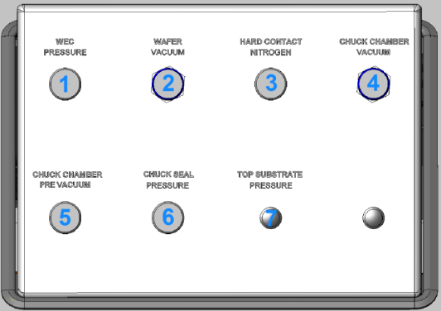
7. Pneumatic control
1、WEC PRESSURE
2、WAFER VACUUM
3、HARD CONTACT NITROGEN
4、CHUCK CHAMBER VACUUM
5、CHUCK CHAMBER PRE VACUUM
6、CHUCK SEAL PRESSURE
7、TOP SUBSTRATE PRESSURE

Slide 50
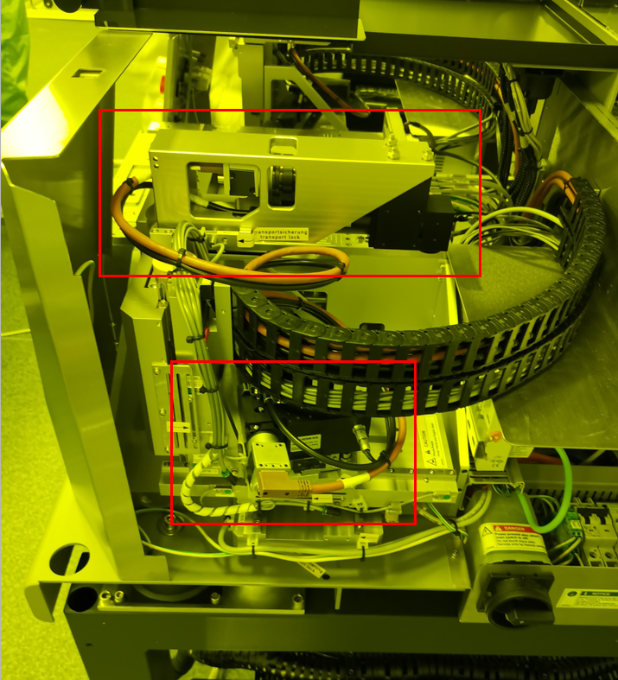
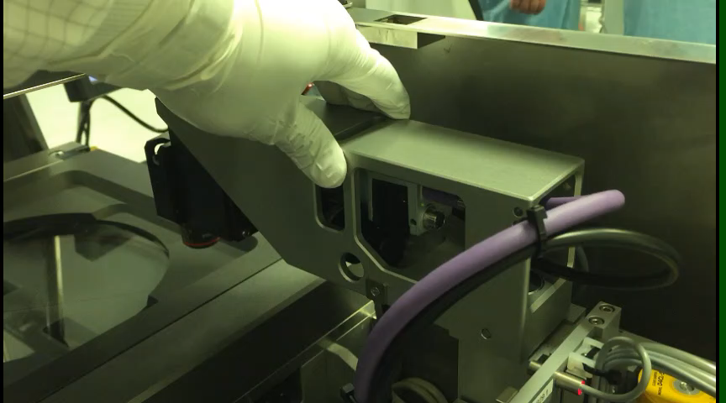
8、TSA/BSA
TSA(TOP SIDE ALIGNMENT)
BSA(BOTTOM SIDE ALIGNMENT)

Slide 51
2、Software overview
1
Softeware overview
2
Create a recipe

Slide 52
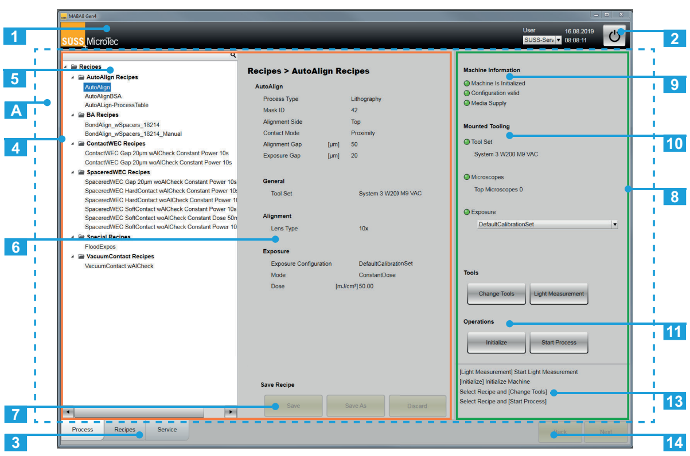
1、Software overview
1、Title Line: SUSS logo, important recipe parameter, time, user, power key
2、Power key
3、Lower frame : include Process\recipe\service
4、Main frame（orange）
5、Recipe folder
6、Recipe Parameter information
7、Function key(recipe save)
8、Process window(green)

Slide 53
1、Software overview
9、Machine information
10、Tooling\exposure information
11、Function key
13、Operation guidance）
14、Function key

Slide 54
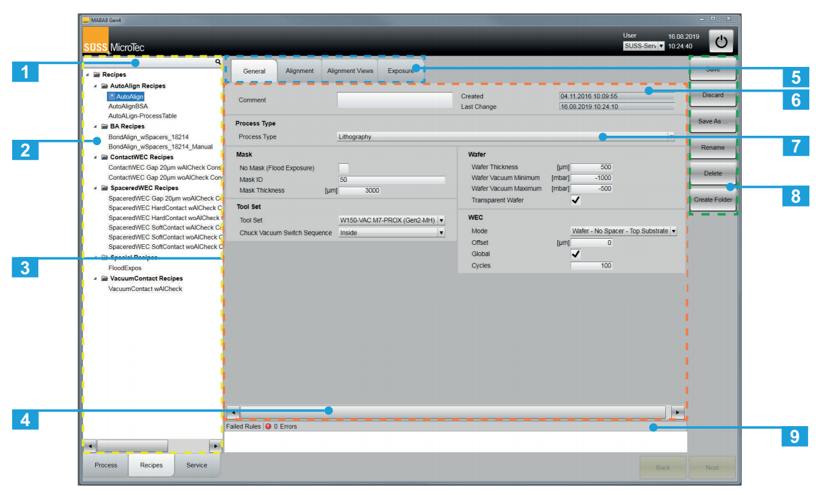
2、create a recipe
1、Recipe search
2、Recipe list(Yellow)
3、Parameter field(Orange)
4、Scroll bar
5、Tabs for recipe(Blue)
6、Recipe Infromation
7、process type
8、Function key
9、Recipe error information

Slide 55
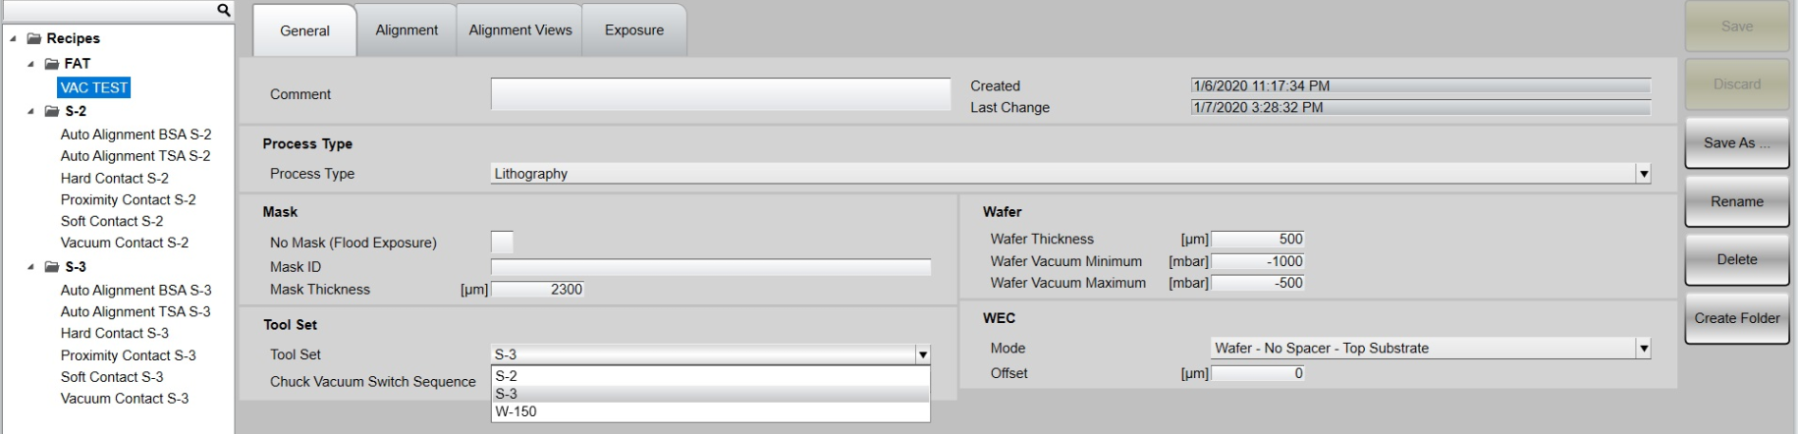
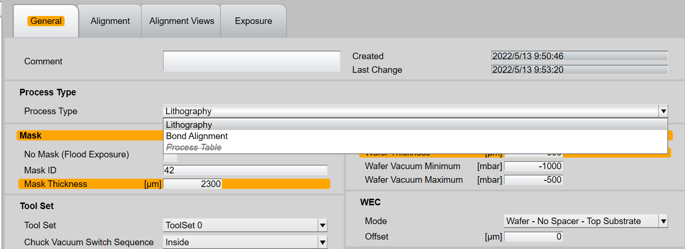
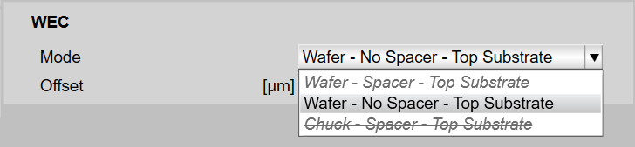
2、create a recipe-general

Slide 56
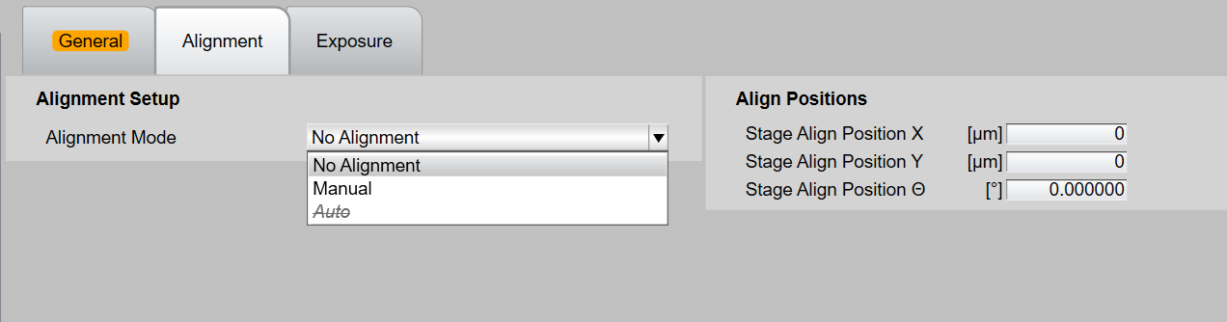
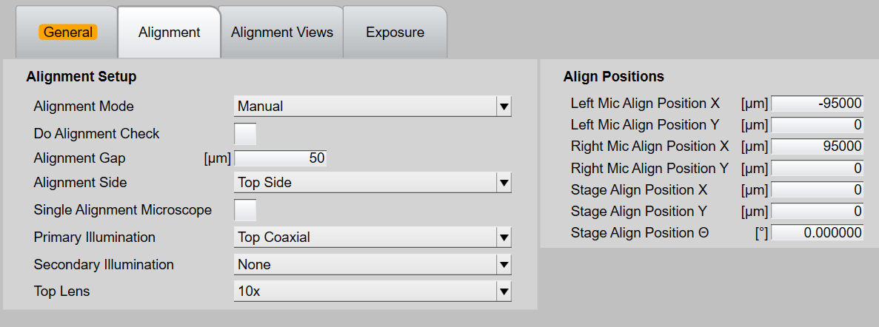
2、create a recipe-Alignment
No Alignment
Manual Alignment

Slide 57
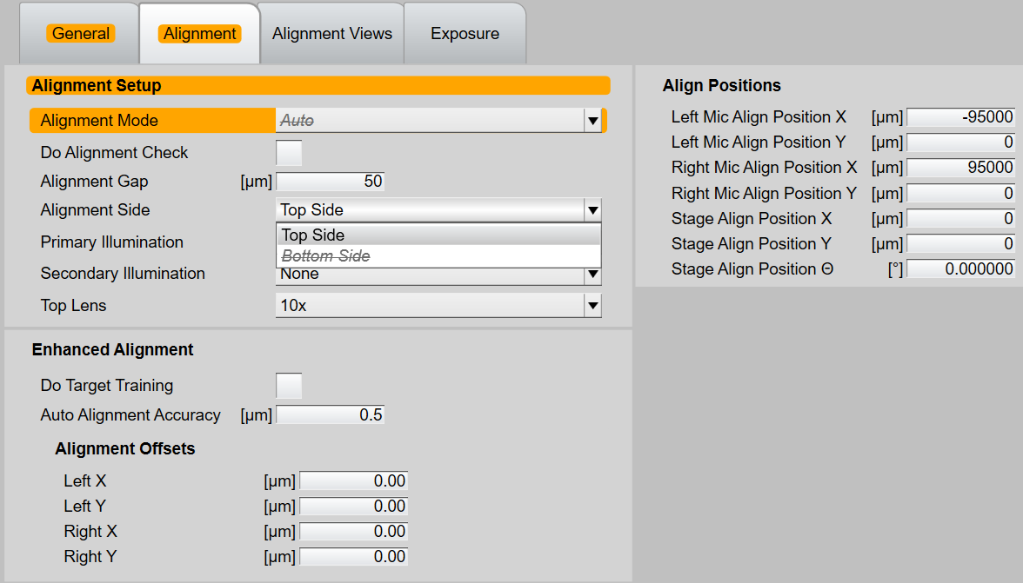
2、create a recipe-Alignment
Auto Alignment

Slide 58
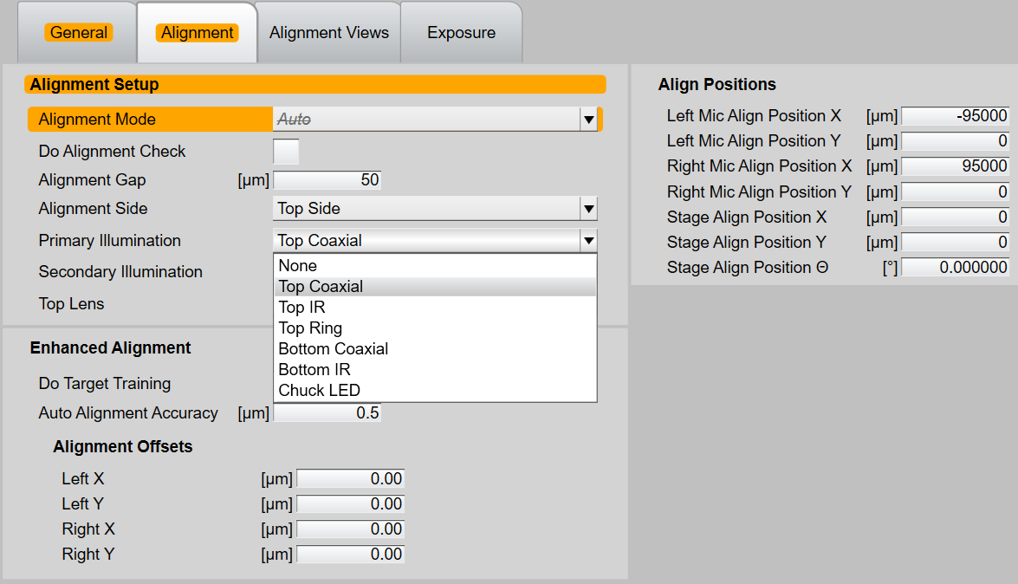
2、create a recipe-Alignment
Choose illumination

Slide 59
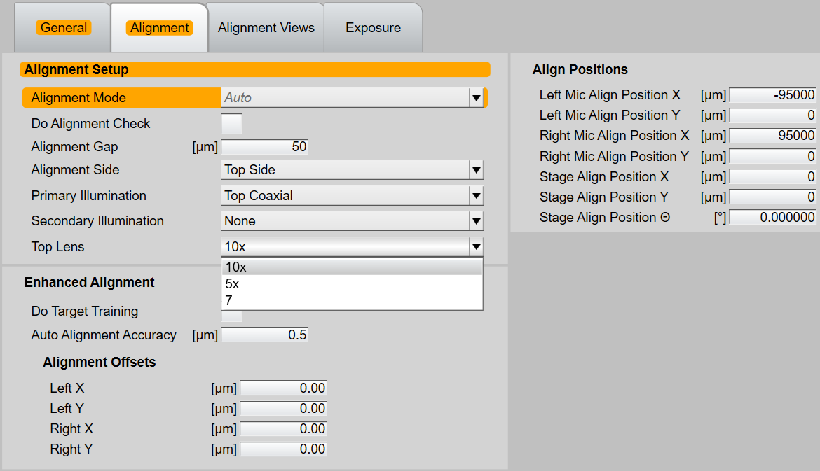
2、create a recipe-Alignment
Choose Lens

Slide 60
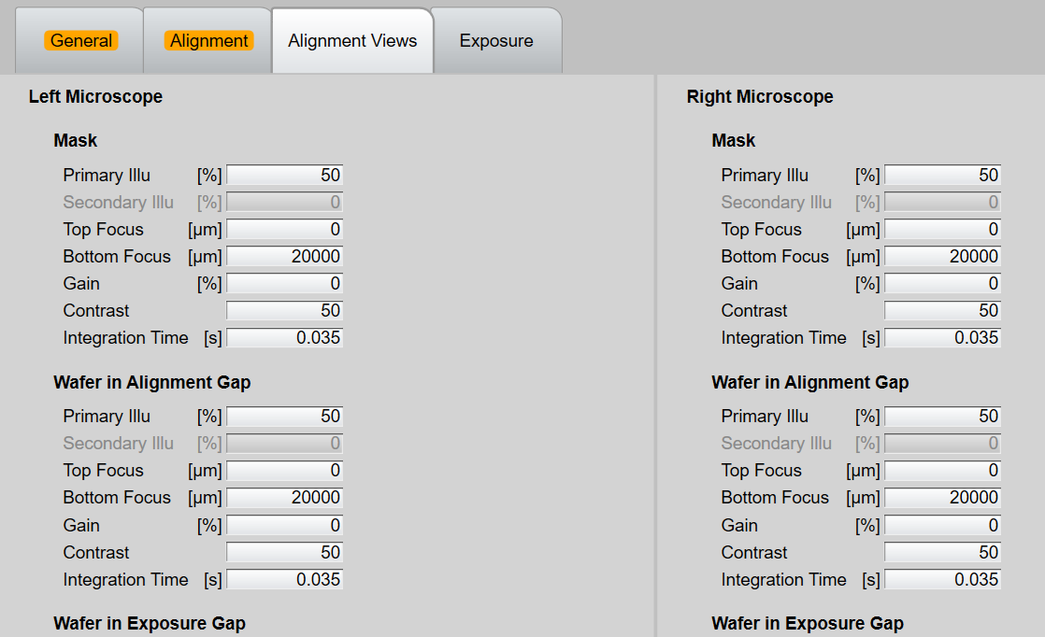
2、create a recipe-Alignment view
No need to modify

Slide 61
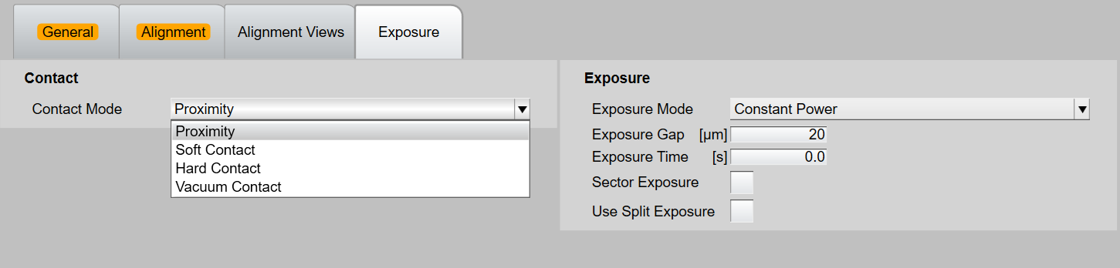
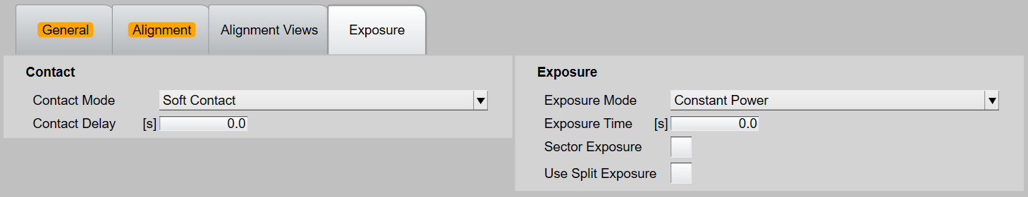
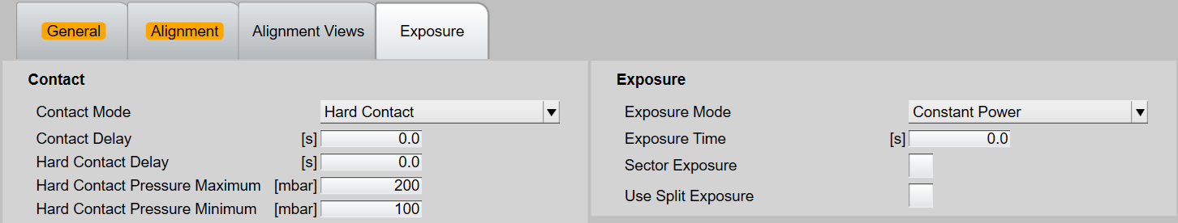
2、create a recipe-exposure
Proximity
Soft contact
Hard contact

Slide 62
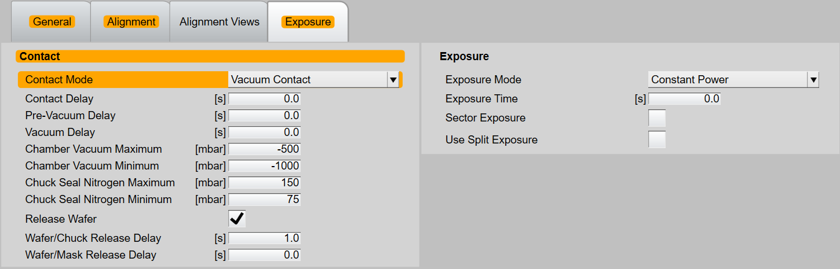
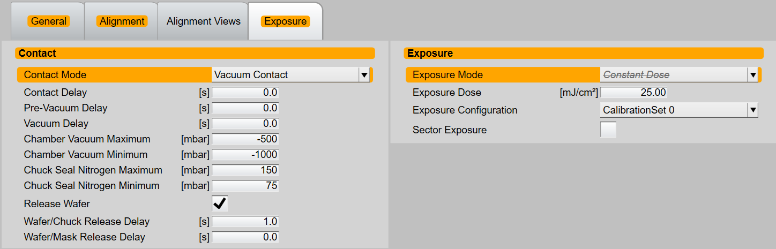
2、create a recipe-exposure
Constant Power
Constant Dose

Slide 63
operation
1
Start a MA process
2
Start the machine
3
Light on and calibrate the intensity
4
Change the tool set
5
Load mask and chuck
6
Start a process without alignment
7
Start a process with manual alignment
8
Start a process with auto-alignment

Slide 64
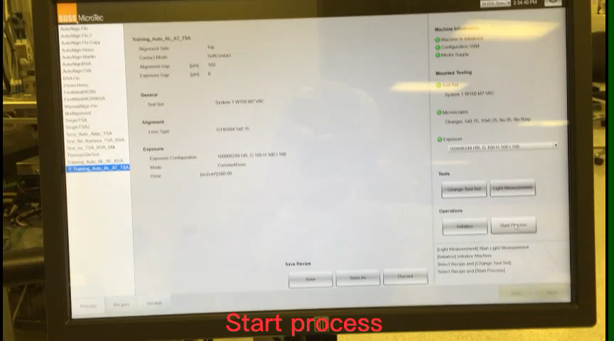
1、start a process

Slide 65
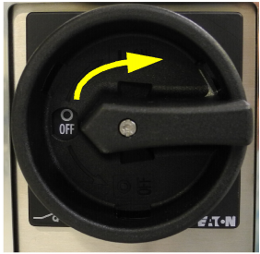
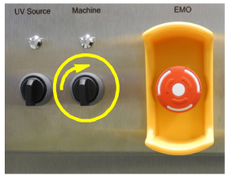
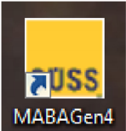
2、start the machine
Main switch on
UV source on
Machine on
Switch on the SW

Slide 66
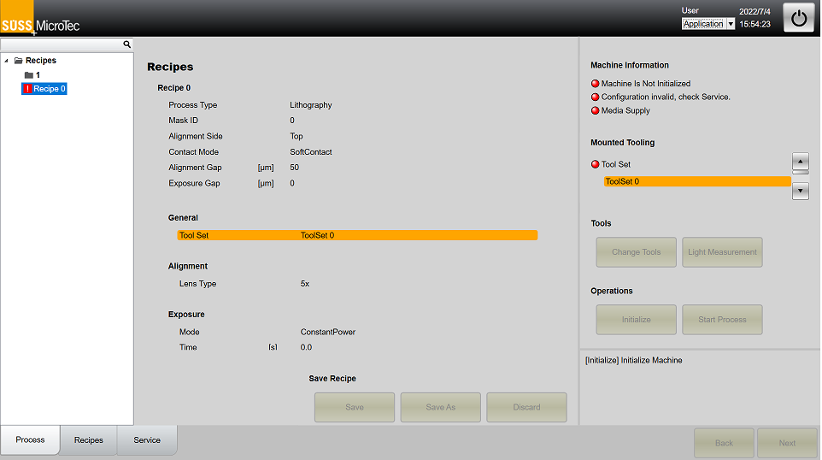
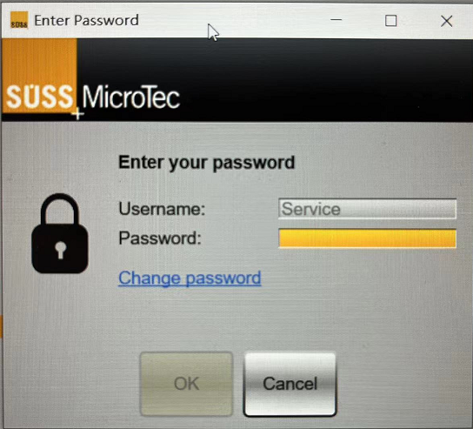
2、start the machine
1、Log in
2、User: Service
3、Password: Service

Slide 67
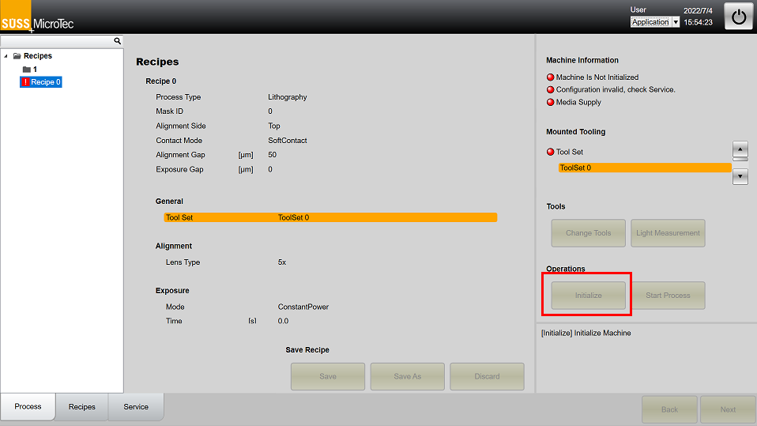
2、start the machine
Initialize the machine

Slide 68
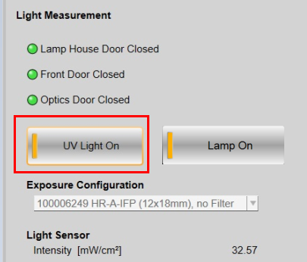

3、light on
Click UV light on open the shutter, we can see the intensity

Slide 69
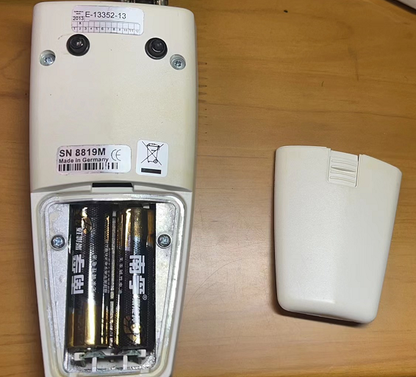
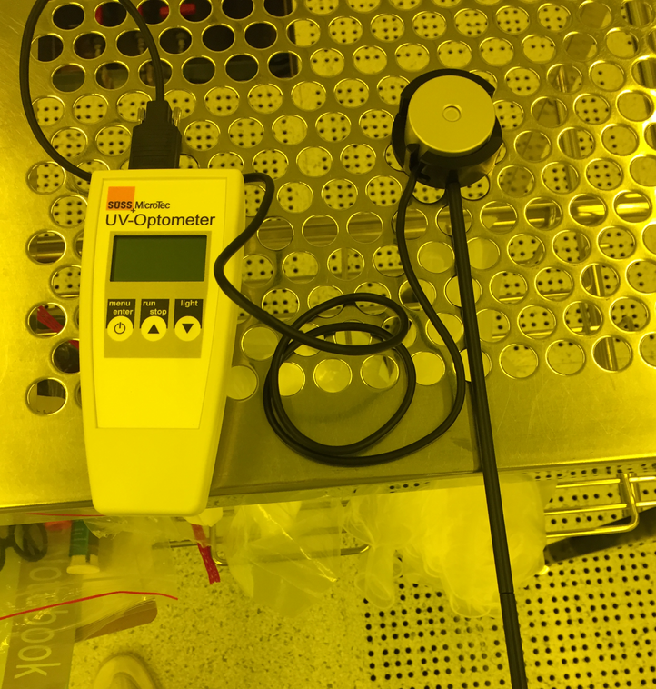
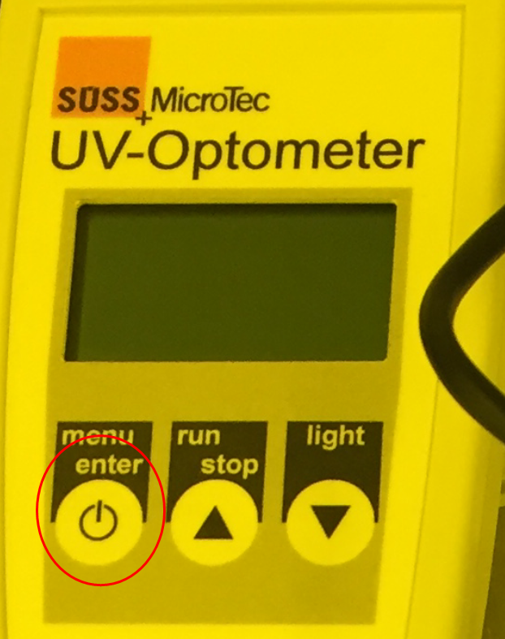
3、calibrate the intensity
Put the battery in the UV-Meter
Connect the UV-Optometer and the the probe
Press and hold the Power button for 3s to switch on the UV-meter

Slide 70
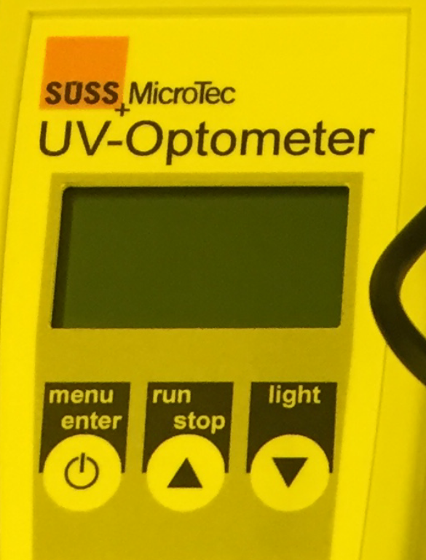
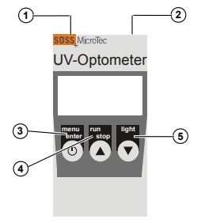
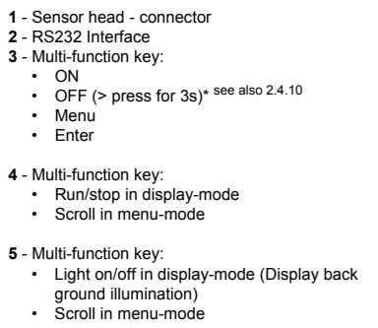
3、calibrate the intensity
First time switch on the UV Meter, you need to set the year/month/date; always choose 1000w lamp

Slide 71
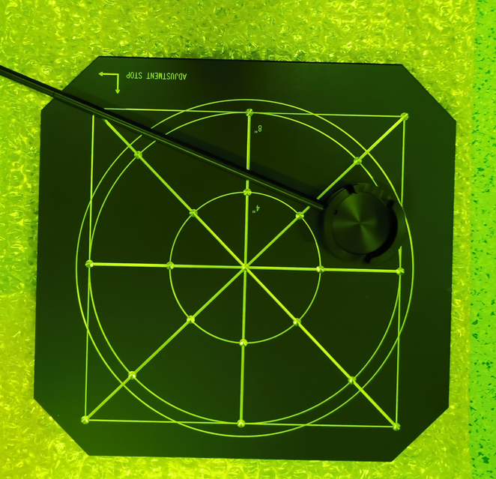
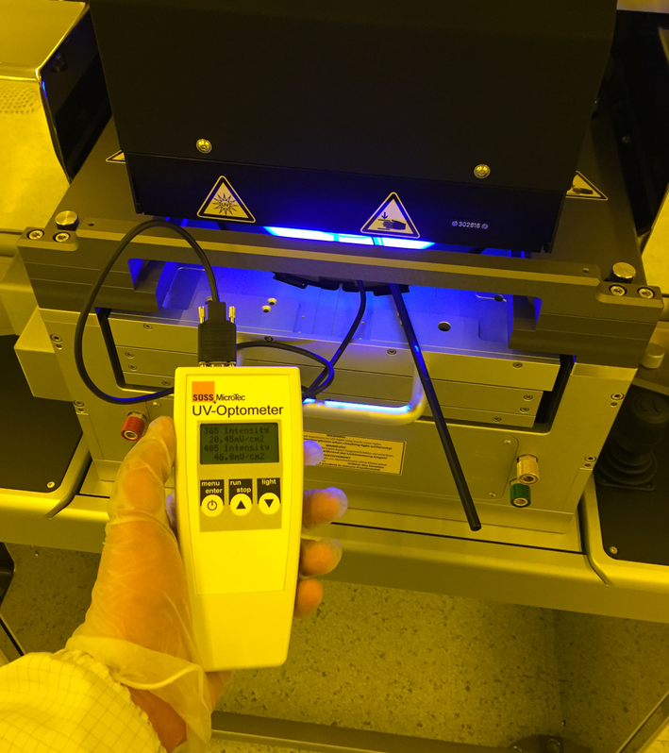
3、calibrate the intensity
Put the intensity position plate on the slide
Put the probe on the intensity plate to measure the light intnsity

Slide 72
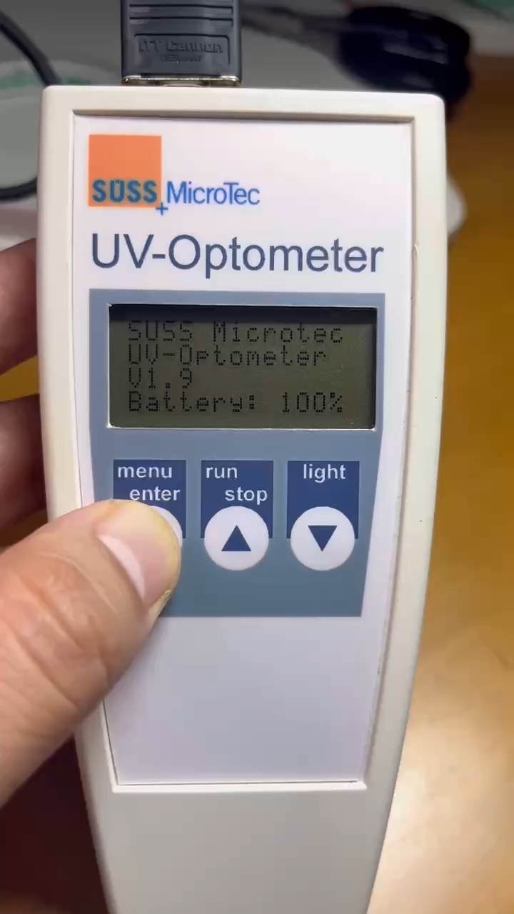
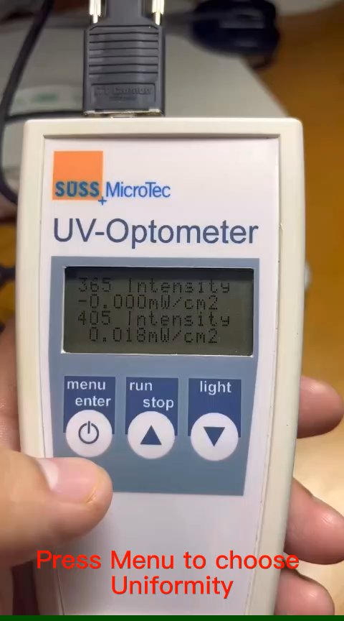
3、calibrate the intensity
Set the time and always choose 1000w lamp
Use the UV-Meter to measure the uniformity and Average intensity

Slide 73
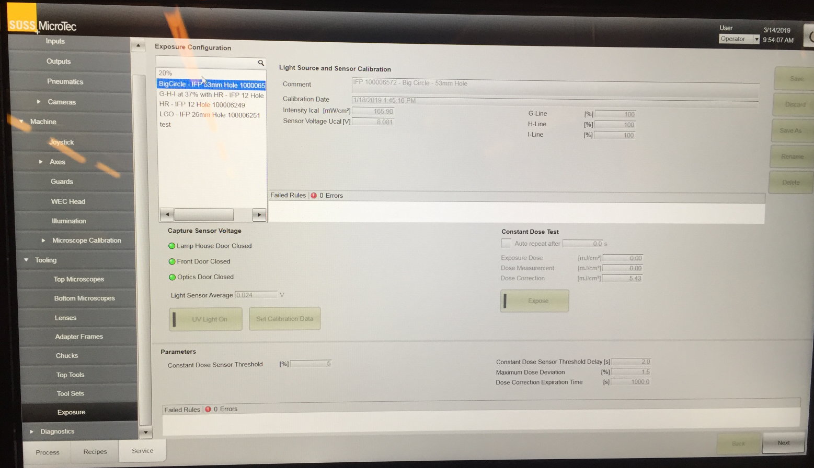

3、calibrate the intensity
1
Go to service---Exposure---click UV light on---put the actual 405nm intensity to position 1---click set calibration
Check the intensity read by machine ,must be the same like the UV-meter

Slide 74
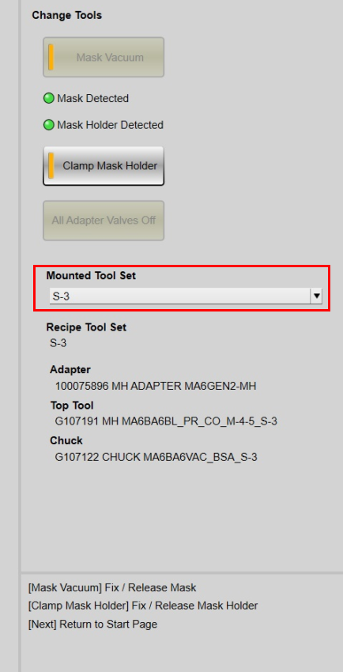
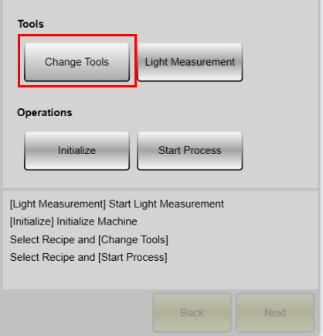
4、change the tool set
Choose the right tool in the list
Click change tools

Slide 75






5、load mask and chuck
Take out the mask holder
Put the mask on the holder
Push mask to stop pin
Click change tools
Switch on the mask vacuum
Clamp the mask

Slide 76






5、load mask and chuck
Load the mask holder
Push the mask holder to the end
Click clamp amsk holder to lock
Chuck should align to the slide
Pull out the slide
Put the chuck on the slide

Slide 77

6、Start a process without alignment
1、choose a recipe without alignment
2、click Start process

Slide 78


6、Start a process without alignment
3、pull out the slide
4、put the chuck onto slide and put the wafer on the chuck
5、click next and push the slide into the machine and click next again
6、Stage will move up to perform the WEC and then expose the wafer

Slide 79
6、Start a process with manual alignment
1、choose a recipe without alignment
2、click Start process

Slide 80
6、Start a process with Manual alignment
3、pull out the slide
4、put the chuck onto slide and put the wafer on the chuck
5、click next and push the slide into the machine and click next again
6、Stage will move up to perform the WEC and then Stage go down to the alignment gap

Slide 81

6、Start a process with Manual alignment
7、click button”1” toggle to Microscope Left/ Microscope right/ Stage to adjust the mask key position to the center and the focus
8、Click button “2” can adjust the speed of the movement, click button “1” toggle to “Stage Xytheta”, to move the wafer align to the mask
9、click button”3” or button”4”, you can toggle the focus between mask and wafer

Slide 82


6、Start a process with Manual alignment
10、Button 1 can adjust the left/right illumination
11、button 2 can zoom in the pattern
12、button 3 save the image
13(option)、button 4/5 can show a cross and the coordinates

Slide 83

6、Start a process with Manual alignment
14、click expose or next to expose the wafer
15、If you click expose, wafer will move to exposure gap and exposed
16、if you click next, wafer will move to exposure gap and stop, when you click next again, wafer will be exposed

Slide 84
6、Start a process with auto-alignment
1、choose a recipe without alignment
2、click Start process

Slide 85
6、Start a process with Auto-alignment
3、pull out the slide
4、put the chuck onto slide and put the wafer on the chuck
5、click next and push the slide into the machine and click next again
6、Stage will move up to perform the WEC and then Stage go down to the alignment gap

Slide 86

6、Start a process with auto-alignment
7、click button”1” toggle to Microscope Left/ Microscope right/ Stage to adjust the mask key position to the center and the focus
8、Click button “2” can adjust the speed of the movement
9、click buttom”3” or button”4”, you can toggle the focus between mask and wafer

Slide 87
6、Start a process with AUTO-alignment
10、Buttom 1 can adjust the left/right illumination
11、buttom 2 can zoom in the pattern
12、button 3 save the image(not necessary)
13(option)、button 4/5 can show a cross and the coordinates

Slide 88

6、Start a process with AUTO-alignment
14、click left mask
15、click Grab live image
16、move the cross roughly to the center of the mask key
17、move the boxes to you mask key
18、click train button
19、click Auto Center Origin
20、click Search
21、the same way to do the mask right/ wafer left/ wafer right

Slide 89
6、Start a process with Auto-alignment
22、Position and view to go back

Slide 90

6、Start a process with Auto-alignment
23、click next to perform auto-alignment
24、After auto-alignment done, you can click expose or click next to expose the wafer

